Slide 1
Literary Romanticism, Realism and Naturalism

Slide 2
Romanticism
Developed in the early 1800’s as a rebellion to Classicism
In its prime during the Renaissance
Usually a story that brings the reader to escape from reality
Deals with distant lands and times
More exciting and adventurous than real life
Individualism was greatly emphasized
Nationalistic pride is often prevalent
Focused on a return to nature
Underlying belief in the goodness of humanity
Characters are idealized
Emotions are elemental, not usually complex

Slide 3
Romanticism (cont.)
Victor Hugo was the most prominent genius of the Romantic school, as well as its leader
Romanticism came to a near halt midway through the 19th century
Waned as science and industrialism increased in the world, literature became more focused on actuality.

Slide 4
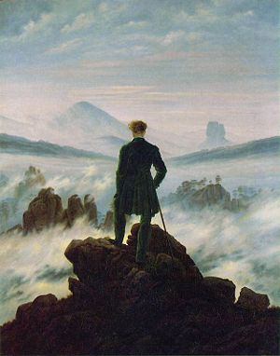
Examples of Romantic Literature & Films
Huck Finn
The Scarlet Letter
Moby Dick
The Shot
Doctor Zhivago

Slide 5
Realism
Became more prominent during the 19th century
Shows how life really is, based on fact and reality
Non-dramatic
Emotions are complicated
Characters and situations are not ideal
Balzac was the most well known representative of realism in fiction
Deepens toward Naturalism

Slide 6
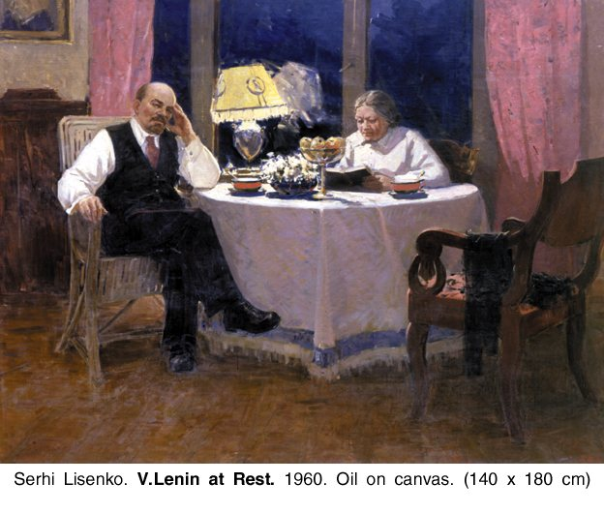
Examples of Realist Literature
Day in the Life of Ivan Denisovich
Great Expectations
Notes From the Underground
“A Doll's House” (Play)

Slide 7
Naturalism
A branch of Realism
View “Nature” is the world of reality- objects, actions, and forces that are studied by science.
Very objective POV
View humans as animals in the natural world
Goes in to explicit, ugly physical detail
Extreme frankness and honest coarseness
Lacks a sense of proportion

Slide 8
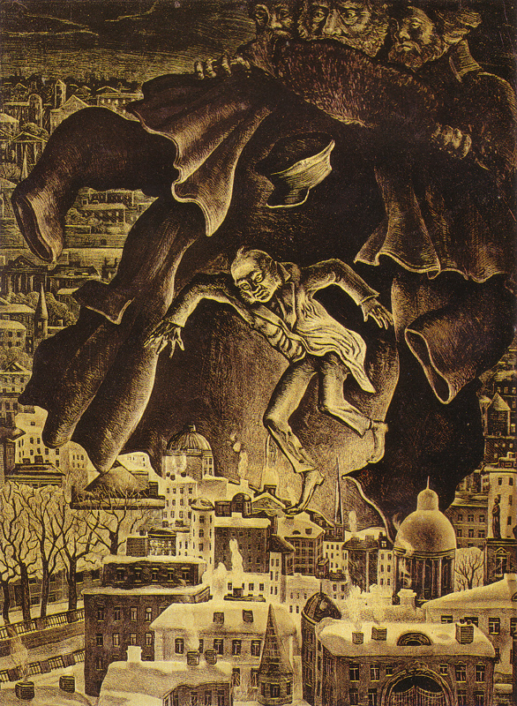
Examples of Naturalist Literature
Crime and Punishment
Of Mice and Men
“The Overcoat”
“To Build A Fire”

Slide 9
Sources
https://www.britannica.com/art/Romanticism
https://en.wikipedia.org/wiki/Romanticism

